Slide 1
DSC530 Final Project
Jay Pfister
12 Aug 2021

Slide 2
The Data
The data use in this project is the over all Twitch.tv viewership data by game across the year 2020.
I specifically focus on World Of Warcraft as a category for the reason that its global twitch rank fluctuates in an interesting way that caught my eye. I used additional data from League of Legends (The over all most popular game globally) as a reference point for what happened with WoW.
The part of the data set that the project focused on was whether or not direct increases in average viewership had an impact on total average hours watched. Seems obvious, but there are other things at play here.

Slide 3
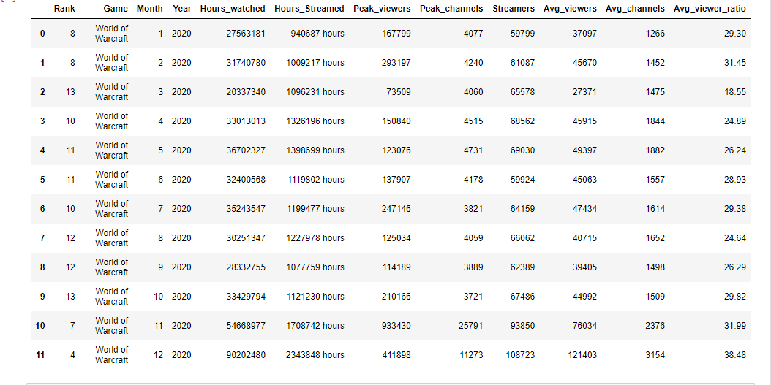
The Data

Slide 4
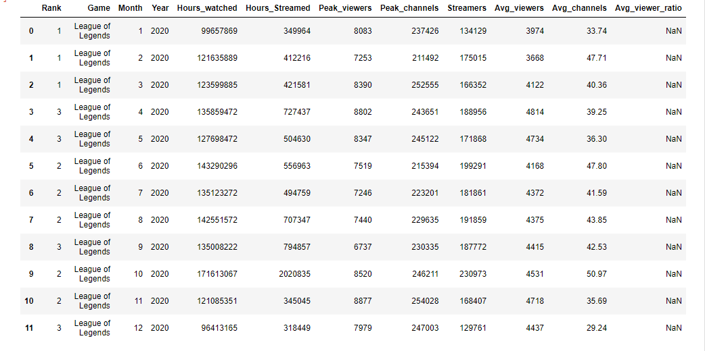
The Data

Slide 5
The Data (Variables Considered)
Rank (Globally on Twitch.tv)
Simply the ranking (by viewership) of a given category on the website Twitch.tv
Average Viewers
Average concurrent viewer count of a category
Hours Watched
Total hours watched across all channels in a category (Game)
Hours Streamed
Total hours streamed across all channels in a category (Game)
Average Channels
Average number of channels live in a given category (Game)

Slide 6
The Variables
The relationship between hours watched and average viewers ( which was the focus of the assignment) is reasonably straightforward (in theory).
Unfortunately, the data does not have a means of accounting for external events that directly impact the streaming landscape which cause interesting anomalies in the numbers in specific cases and were the reason I chose this data in the first place.
Other variables that had an impact such as hours streamed and average channels are also connected to the viewership data but weren’t the focus of the exploration and my attempt to understand why there were anomalies in the viewership data.

Slide 7
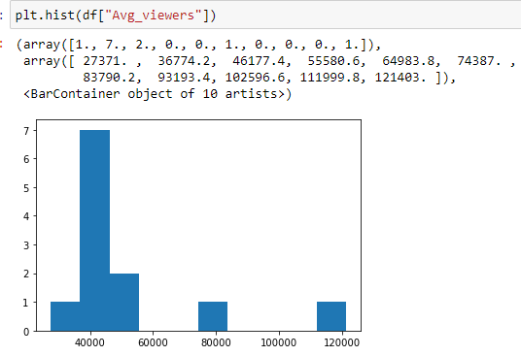
Average Viewers (WoW)

Slide 8
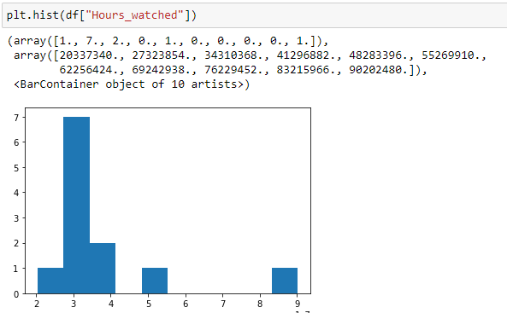
Hours Watched (WoW)

Slide 9
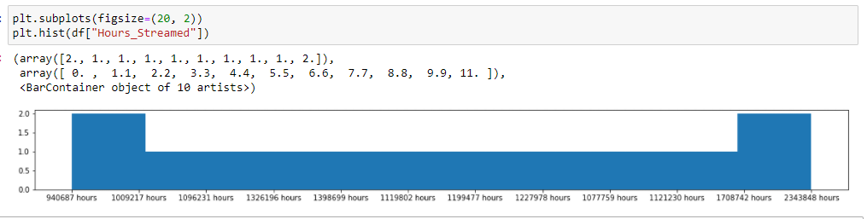
Hours Streamed (WoW)

Slide 10
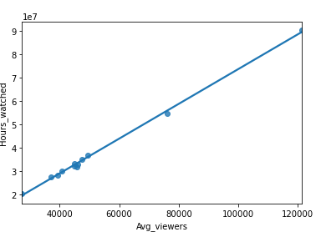
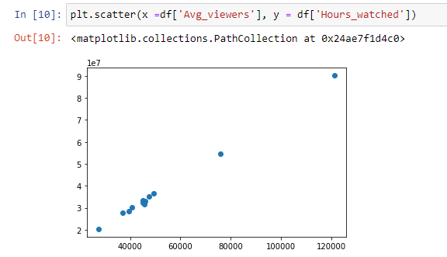
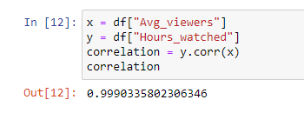
Average Viewers/Hours Watched (WoW)

Slide 11
Correlation
It’s fair to say, with a correlation ratio of .999 that the values of Average Viewership and Hours Watched are directly correlated, nearly 1 to 1.

Slide 12
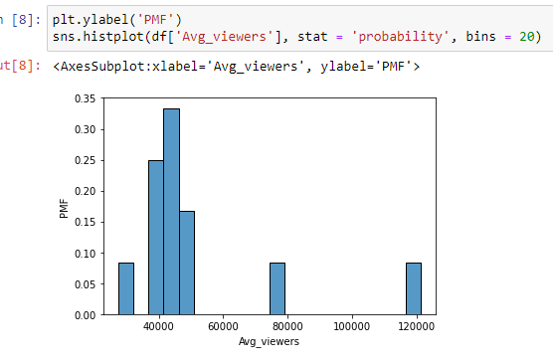
Probability Function (WoW)

Slide 13
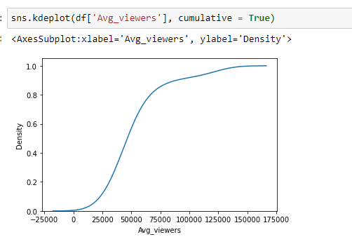
CDF WoW Views
This chart represents the distribution of the data in the “Avg_viewers” column of of the World of Warcraft data across the entirety of the WoW category on Twitch.tv. Values that occur often appear here as a steep curve where as values that occur less frequently are represented by a flattening of the line.
Over all, this indicates that the average viewership of World of Warcraft is high across Twitch.

Slide 14
Outliers
There aren’t many cases of true outliers in this data set. Most of the dramatic change you can see month over month can be explained by external factors.
There is an outlier in the League of Legends viewership data that appears to coincide with a major tournament event on the professional League of Legends pro scene which would account for the increase in viewers but across fewer channels and less time actually streamed. With this explanation, it is probably best to discard this outlier.

